Slide 1

Advisory Board for Club Sports

Slide 2
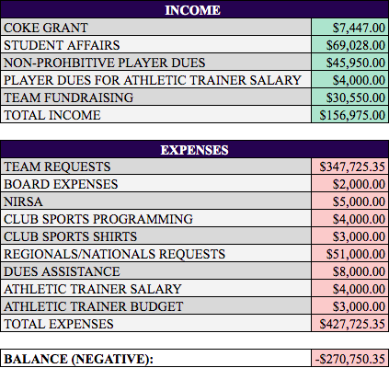
Initial Budget Request FY21

Slide 3
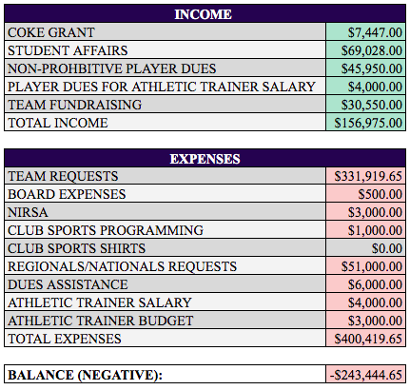
Appeals Budget Request FY21

Slide 4
Team Requests
Initial allocation: $347,725.35 | Adjusted allocation: $331,919.65
Team budget requests for funding increase every year
Off-campus costs increased this year
8 teams with budgets over $10,000
Triathlon in restoration this year - had to request Ad Hoc (requested over $10,000)
Skiing did not get a budget allocation - had to request Ad Hoc (requested over $10,000)
FY20 - forced to cut ABCS funding for all individual membership dues
Included as a separate item under the Group Budgets tab, even though these are included in individual teams’ budgets
Club Sports members who have to pay membership dues are paying, out of pocket, $27,039.50 to compete
Decrease in Club Sports participation due to this cost
Even if we are unable to fund every single team allocation, we want to be able to fund essential expenses that prioritize the safety of our athletes and the mission of the Club Sports Community

Slide 5
Club Sports Programming & Board Expenses
Initial allocation: $9,000.00 | Adjusted allocation: $1,500.00
Cut all non-essential Club Sports programming in FY20
Essential Club Sports Programming
Club Sports Open House - prior to CAB Fair, because a lot of teams have tryouts either before or during the weekend of CAB Fair
MANDATORY Club Sports Leaders Seminar - the club-sports specific Blueprint Training

Slide 6
Dues Assistance Program
Initial allocation: $8,000.00 | Adjusted allocation: $6,000.00
An opportunity for students experiencing financial barriers to compete in Club Sports - ABCS covers a portion or all of an individual’s team dues requirement
High (team dues greater than $300) - fund 0-50%
Moderate (team dues between than $51-$299) - fund 50-100%
Low (team dues between $25-$50) - fund 100%
Dues Assistance allocated (FY20): $5,316.50
Average team dues (FY20): $91.91 (up to $825)
Goal of reducing the average to under $50
Increase Dues Assistance Program Funding
As this program becomes more popular, more people are taking advantage of it - looking to work with Office of Student Financial Services and GSP to assess sustainability/how to better determine need
Individual equipment funding, Hoya Hospitality/Hoya Hub for food/travel stipends in the future

Slide 7
Budget FY21 Appeal: $243,444.65
The additional $5,192.35 is necessary to…
Support individual athletes in lowering dues, equipment costs, and uniform costs
Prioritize the safety of Club Sports athletes in travel and practices
Fulfill the competitive mission of the Club Sports Community by allowing teams to practice, compete, and strive for health and wellness
Commit to our teams that we are doing what we can to reduce financial barriers to competing in Club Sports

Slide 8
Primary Goal: Decrease the financial burden on individual members within the Club Sports community.

Slide 9
Questions?

